Slide 1
Supporting care commissioners and procurers to promote “social value” models of delivery
A collaborative exploration of the transformational agenda set out in Section 16 of the Social Services and Well-being (Wales) Act 2014
With due regard to agendas such as Rebalancing The Care Market, Future Generations, Healthier Wales, Market Stability and the Foundational Economy
Notes:
Hi everyone
This is the title of our report, which arose from work funded by Welsh Government via the Wales Co-op Centre in late 2019, cut short by Covid but now starting up again.
The report surfaces some of the whats and whys of social value models and introduces an agenda for how they can be promoted.
First up, a big what…

Slide 2
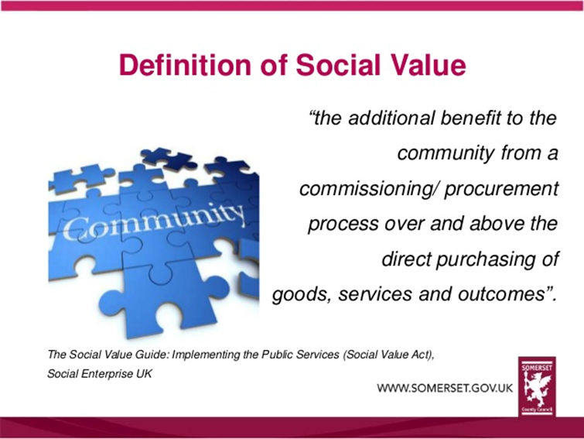
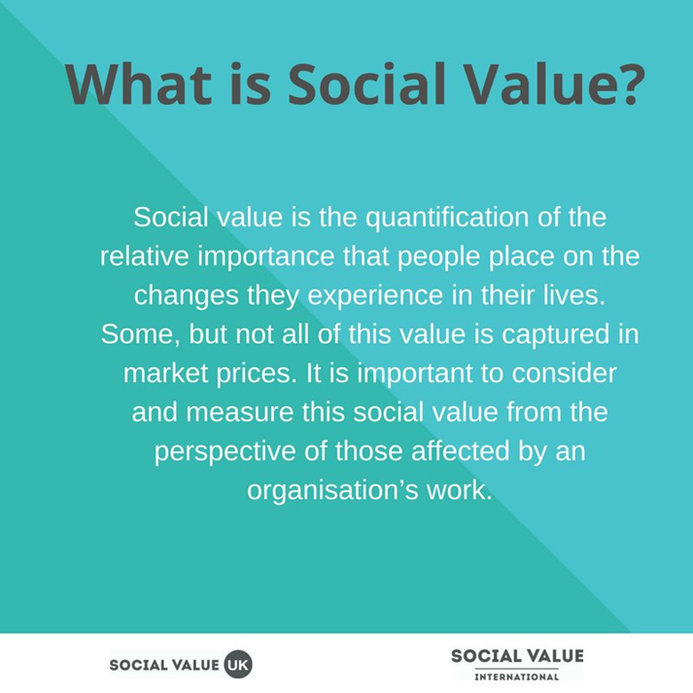
What is Social Value?
Notes:
There is no single, agreed definition of “social value”. For some it is about what is important to the end-users of a service. For others it is about extracting additional community benefits from a supplier. In social care in Wales it has been used to create phrases like “social value organisations” and “social value forums”, but the result has often been arguments about who should be included. These phrases have been used as short-hand for organizations referenced in Section 16 of Part 2 of the Social Services and Well-being Act. It’s therefore helpful to have a closer look at what Section 16 actually says.

Slide 3
Section 16, Part 2 of the SS&WB Act
Promoting social enterprises, co-operatives, user led services and the third sector
A local authority must promote—
the development in its area of social enterprises to provide care and support and preventative services;
the development in its area of co-operative organisations or arrangements to provide care and support and preventative services;
the involvement of persons for whom care and support or preventative services are to be provided in the design and operation of that provision;
the availability in its area of care and support and preventative services from third sector organisations (whether or not the organisations are social enterprises or co-operative organisations).
Notes:
The wording of the Act describes five models, and only three of them are “organisations”:
1. Social enterprises
2. Co-operatives
3. Other third sector organisations

Slide 4
Section 16, Part 2 of the SS&WB Act
Promoting social enterprises, co-operatives, user led services and the third sector
A local authority must promote—
the development in its area of social enterprises to provide care and support and preventative services;
the development in its area of co-operative organisations or arrangements to provide care and support and preventative services;
the involvement of persons for whom care and support or preventative services are to be provided in the design and operation of that provision;
the availability in its area of care and support and preventative services from third sector organisations (whether or not the organisations are social enterprises or co-operative organisations).
Notes:
The inclusion of “co-operative arrangements” as well as “co-operative organisations” within the section 16 duty encourages authorities to consider the potential value of arrangements that might extend from informal self-help groups to multi-agency consortia.
The use of the phrase “user led services” in the heading, rather than “user led organisations”, should also be noted, along with the emphasis in the wording on user involvement in the design and operation of provision. Whilst user involvement might be particularly likely in a “user-led organisation”, the Act is encouraging the promotion of a user-led approach in all organisations

Slide 5
The implications for including for-profits in “social value” models in Wales
Section 16 does reflect a strong push in the direction of not-for-profit organisations, but it also includes a rationale for including the for-profit sector:
  They too can co-operate with others
  They too can involve users in the design and operation of their provision
  They can also change…
Notes:
Section 16 and the whole of Part 2 of the Act is intended to support the transformation of services in Wales so that they achieve the best possible outcomes and are more financially sustainable. A focus solely on not-for-profits would mean excluding a large part of the care sector from this agenda, and such an exclusion did not sit comfortably with many of the commissioners we spoke to.
For reasons of stability and fairness, it makes far more sense to engage for-profits in a process of improvement and transformation than to leave them outside. And Section 16 opens the door for this.
But there is a price of entry.
The Codes underneath section 16 make it very clear that there is an expectation of values and behaviours which reflect the principles of the Act. So whatever sector or business type an organisation might be, it needs to demonstrate its commitment to these principles.
Above all, they should be striving to work with people in accordance with the principles and practice of co-production, and that means empowering service users.
And genuinely empowered users of services may ask questions about what happens to profits made by their support provider. They may also be strong advocates of profits being reinvested into quality of service and fair pay. This may not be a welcome direction of travel for some for-profit providers, but let’s see who gets on board. The best of our for-profits may be as keen as anyone.

Slide 6
The five principle-based goals of the Act: and why not-for-profits might have an edge
Principle-based goals | Not-for-profit credentials
Well-being outcomes: Providers do what matters - as people define it | Often directly linked to core purpose. If user-led, more likely to do “what matters”
Co-production: They mobilise people’s own opinions and assets – including community | Often have strong local connections. If member based, these assets are mobilised
Co-operation: They work with others for shared public benefit | Local roots and ethical values may encourage collaboration
Prevention: They think long-term and act to reduce or avoid dependency | Locality and user/carer orientation leads to whole-life/whole population engagement
Added Value: They strive to go beyond just delivering a contract | Values and constitutions should encourage added value
Notes:
Here’s a quick look at the five principle-based goals that underpin the Section 16 duty, and why not-for-profits might have an edge.
The Act wants to see providers that can deliver great well-being outcomes and do what matters as end-users define it. Many not for profits were set up to do exactly this.
The Act wants to mobilise people as coproducers of their own well-being and the well-being of the wider community. Many not for profits have strong local connections and an asset base of active members.
I won’t go through them all, but it’s the same for Co-operation, Prevention and Added Value. For each principle-based goal of the Act there is a potential read-across to the credentials of not for profits.

Slide 7
Alignment with other Welsh laws and policies
Social Services & WB Act | Healthier Wales | Future Generations Act | Foundational Economy
Well-being outcomes | Well-being outcomes | Well-being outcomes | Decent lives and communities
Voice and Control / Coproduction | Coproduction | Citizen / User Involvement | Bottom-up solutions
Partnership and Integration | Partnership | Collaboration | Cross-sector place-making
Early Intervention / Prevention | Prevention | Prevention | Community development
Added Value | Added or Increased Value | Long-term | Trusted suppliers – recycling funds
Notes:
This slide shows how the 5 principles of the Social Services Act are closely aligned with other key Welsh laws and policies.
Healthier Wales and the Future Generations Act use almost identical language.
The Foundational Economy agenda also has a clear overlap of outcomes and approaches.
So the apparent credentials of not-for-profits might suggest that simply giving them more care contracts would lead to a whole raft of policy objectives being fulfilled. But the world is not that simple.

Slide 8
The five principle-based goals from the Act: and why not-for-profits might have an edge
Principle-based goals | Not-for-profit credentials
Well-being outcomes: They do what matters - as people define it | Often directly linked to core purpose. If user-led, more likely to do “what matters”
Co-production: They mobilise people’s own opinions and assets – including community | Often have strong local connections. If member based, these assets are mobilised
Co-operation: They work with others for shared public benefit | Local roots and ethical values may encourage collaboration
Prevention: They think long-term and act to reduce or avoid dependency | Locality and user/carer orientation leads to whole-life/whole population engagement
Added Value: They strive to go beyond just delivering a contract | Values and constitutions should encourage added value
Commissioners can’t just presume an organization has an edge, especially when applying contract regulations
Notes:
Sections 20 and 77 of the Public Contract Regs do provide a bit of wriggle room for reserve contracts, but the general rule is you must provide a level playing field for all providers.
Hence it helps to see the Section 16 duty as a doorway for everyone to come through, rather than as a barrier to keep anyone out.
When it comes to the letting of care contracts, instead of focusing on the label of an organization, commissioners and procurers should focus on specifying, scoring and measuring the multiple outcomes they want.

Slide 9
Commissioning for multiple outcomes – the procurement route
WHAT: increased presence of models that: | HOW: award points for providers that:
Achieve great well-being outcomes | Co-produce well-being and enable people to connect and contribute
Give users a strong voice and real control. | Empower users in their constitution, and/or in their model of support
Have a proactive, preventative orientation. | Demonstrate their commitment to prevention
Involve collaboration and partnership | Demonstrate their commitment to collaborate
Add economic, environmental and/or social value | Demonstrate their commitment to adding value
Notes:
This is the first of my How slides and picks up on the point about specifying and scoring.
On the left is the principle-based agenda that commissioners should build into their specifications.
On the right are the attributes that providers should be trying to demonstrate.
All commissioners will be familiar with this tender scoring approach, but using it in order to shape models of delivery and achieve multiple strategic objectives is a new challenge. And what commissioners have told us is that they require leadership support and on-going opportunities to experiment and learn.

Slide 10
Commissioning for multiple outcomes: before and after procurement
Role model co-production (talking with users and carers)
  What (and who) is working for them?
  Does anything need to change?
Role model collaboration (talking with providers)
  Are they delivering on the principles of the Act?
  Can you help?
Use measures with providers that track multiple outcomes
  This also helps providers build evidence of their achievements
Notes:
This is my second How slide.
The road to social value is not just about tendering.
What happens before and after procurement is crucial for long-term change.
Commissioners need the capacity and the support from leaders to walk their patch and find out what is working and who needs help.
That way they can learn more about what to buy and from whom.
And they can build trust and create ownership of the change agenda.
Multiple outcome measures can also help.

Slide 11
Building capacity “beyond the market”
Some suggested commissioning goals
More people are able to obtain “what matters” to them without (direct) recourse to public services.
More people are engaged in helping each other at the family and community level.
More people are able to choose and access a wide range of well-being related activities.
More people are experiencing empowerment through peer groups and collective action.
More people retain their well-being and independence for longer.
There are valuable citizen-led organisations in every community of viable size.
Notes:
My third How slide argues that we need commissioners to build capacity beyond the market.
It is easy to lose sight of the fact that two of the key principles underpinning Part of the Act are completely dependent on the involvement of citizens and communities.
Co-production requires citizen and community voices and assets to be valued and mobilized. Prevention requires citizens and communities to take some responsibility for their own well-being, and to have information and activities which keep them upstream of “care”.
So if commissioners are going to switch on unpaid self-help capacities, and switch off avoidable future demands, they need to think citizens and communities.
This slide suggests what might be relevant commissioning goals for this.

Slide 12
Building capacity “beyond the market”
Some suggested commissioning activities
Develop a network-based system for obtaining insight into how citizens and communities are doing
Evaluate Information Advice and Assistance (IAA) systems and invest in their improvement
Use grants to support community initiatives (and local anchor organisations) that strengthen people’s ability to maintain well-being and help one another
Build a locality orientation into care and support contracts whenever appropriate
Use Social Value Forums and County Voluntary Councils as vehicles in support of citizen empowerment (co-production) and independence (prevention)
Notes:
And here’s some suggested commissioning activities.
Systems for understanding citizen needs and capacities.
Grants to support community initiatives.
Using Social Value Forums and CVCs to support citizen empowerment and independence.
Wales has been described as having an Implementation Gap, with great policies aimed at empowering communities but no capacity at the local level to turn these policies into realities on the ground. There is some truth in it, but certainly not everywhere. It would be good to surface some case studies of the efforts that are already being made to build capacity beyond the market. But where necessary, let’s invest in commissioning capacity.

Slide 13
Reminder: Why the Section 16 duty is important - and due for attention
Sustainability
  Implementing Section 16 is all about creating a sustainable pattern of services and supports that enable people to achieve great well-being outcomes.
Transformation
  Since 2016 the agenda has been dominated by Part 9 of the Act, focused on the integration of health and social care
  The transformational aspiration of Part 2 of the Act needs to come back in focus.
Notes:
Here’s a reminder of core messages before I close.
Implementing Section 16 is all about creating a sustainable pattern of services and supports that enable people to achieve great well-being outcomes. That means shaping the market so that more and more provision is delivering on the principles and adding social value. It also means empowering citizens and communities - inside care provision so that it delivers what matters to them, and outside care provision so that potentially they never need it.
This is a transformational agenda.
But the focus of RPBs since 2016 has been on high level statutory activities such as population assessments and the pooling of budgets and this has left the transformational, citizen-enabling requirements of the Act on the outer margins of commissioning.
This isn’t what the commissioners we have spoken to want.
But they need more allies, and a clear message that Part 2’s hour has come…
Welsh Government’s funding of today’s report, and the work programme to follow, is therefore very welcome.

Slide 14
Summary: the what, why and how of social value models
What are “social value models”:
  “By their fruits ye shall know them”
Why are they important:
  Not for some quick “added value”, but for long-term sustainability
Surfacing how to promote them:
  Scoring for multiple outcomes
  Role modelling coproduction and collaboration
  Building capacity amongst citizens and communities
Notes:
So… that’s a quick run through of the first section of our report which surfaces the what and why of “social value models” and starts to surface some of the hows.
Now I was going to hand over to Rhian Edwards to talk a bit more about the report Recommendations and Next Steps.
So bear with me as I try to fill her shoes.

Slide 15
Create an environment in which social enterprises, cooperatives and charities are more likely to flourish - whilst simultaneously encouraging for-profit providers to develop their capacity for delivering public benefit.

Slide 16
Recommendations – How To
Commissioning for Multiple Outcomes – The Procurement Route
What other policy tools are available – grants / in-house / JV / Social Innovation Partnerships / Social Impact Bonds.
How do we use the PCRs to better effect?
How do we make tenders less onerous?
How do we take a more proportionate approach to risk?
How to specify, score and monitor the social value outcomes more effectively?
How do we support suppliers to report and measure impact more effectively?
Notes:
Procurement isn’t the only vehicle for pursuing social value objectives, some of which may be better achieved using different policy tools within the council.
PCRs – not just focus on the organisational type but arrangements.
Tenders - Public Contracts Regulations allow commissioners to award contracts on the basis of specified outcomes. Meaningfully scoring against overarching policy objectives will lead to multiple well-being and sustainability outcomes. Measuring performance against over-arching policy objectives will help to identify and reward genuinely trusted suppliers.
Piece of work on TOMS.
Supply side – need to ensure suppliers have the skills to be able to demonstrate their social value as part of the tender process, particularly if a social enterprise when they might struggle to compete on cost. The Social Enterprise Academy has been engaged as a delivery partner to deliver training on measuring social impact.

Slide 17
Recommendations – How To
Commissioning for Multiple Outcomes – Before and After Procurement
How to engage with providers more effectively?
How do we upskill the market on measuring social impact and outcomes.
How do we apply co-production more widely?
Notes:
Engagement – in service design, in benchmarking social value contributions.
Co-production – knowing when co-production will be meaningful and impactful / processes for co-production.

Slide 18
Recommendations – How To
Commissioning Beyond the Market
How do we use grants more effectively?
How to understand citizen needs and community capacity?
How to build a locality orientation into care contracts?
How do we capture learning from work across Wales more effectively?

Slide 19
Next Steps
We are keen to hear if you would like to work through practical solutions with us.
Complete the expression of interest form issued after this event - donna.coyle@wales.coop - deadline for information is Friday 8th January – identify themes of development you are interested in.
Co-produce our activity programme from Jan - March with those who express and interest in working with us.
Meeting with WG Foundational Economy Social Care Community of Practice – Dec 17th.
Notes:
Work we do with those interested will be used to support the development of resources and learning that can be shared across Wales.
Themes
Specifying and scoring for social value and multiple outcomes
Commissioning for social value, before and after procurement
Building capacity beyond the market
Other?

